Slide 1
Branch and Bound
Searching Strategies
Updated: 12/27/2010

Slide 2
Feasible Solution vs. Optimal Solution
DFS, BFS, hill climbing and best-first search can be used to solve some searching problem for searching a feasible solution.
However, they cannot be used to solve the optimization problems for searching an (the) optimal solution.

Slide 3
The branch-and-bound strategy
This strategy can be used to solve optimization problems without an exhaustive search in the average case.

Slide 4
Branch-and-bound strategy
2 mechanisms:
  A mechanism to generate branches when searching the solution space
  A mechanism to generate a bound so that many braches can be terminated

Slide 5
Branch-and-bound strategy
It is efficient in the average case because many branches can be terminated very early.
Although it is usually very efficient, a very large tree may be generated in the worst case.
Many NP-hard problem can be solved by B&B efficiently in the average case; however, the worst case time complexity is still exponential.

Slide 6
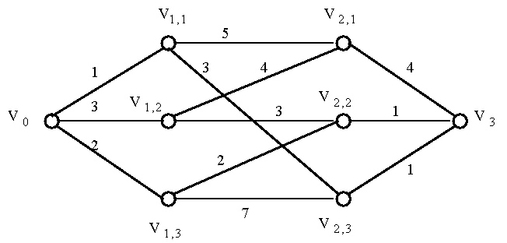
A Multi-Stage Graph Searching Problem.
Find the shortest path from V₀ to V₃

Slide 7
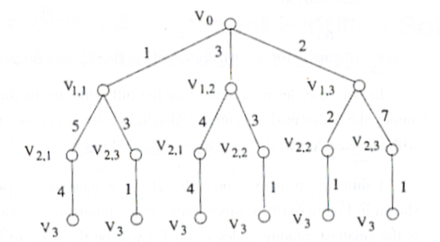
E.G.:A Multi-Stage Graph Searching Problem

Slide 8
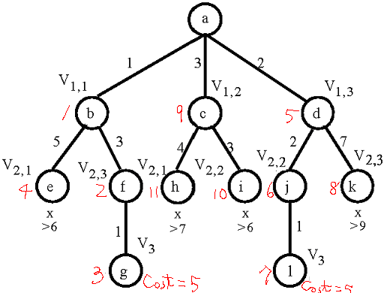
Solved by branch-and-bound (hill-climbing with bounds)
A feasible solution is found whose cost is equal to 5.
An upper bound of the optimal solution is first found here.

Slide 9
For Minimization Problems
∞
Upper Bound
(for feasible solutions)
Usually, LB<UB.
If LB≥UB, the expanding node can be terminated.
Optimal
Lower Bound
(for expanding nods)
0

Slide 10
For Maximization Problems
∞
Upper Bound
(for expanding nods)
Usually, LB<UB.
If LB≥UB, the expanding node can be terminated.
Optimal
Lower Bound
(for feasible solutions)
0

Slide 11
The traveling salesperson optimization problem
Given a graph, the TSP Optimization problem is to find a tour, starting from any vertex, visiting every other vertex and returning to the starting vertex, with minimal cost.
It is NP-hard.
We try to avoid n! exhaustive search by the branch-and-bound technique on the average case. (Recall that O(n!)>O(2^{n}).)

Slide 12
The traveling salesperson optimization problem
E.g. A Cost Matrix for a Traveling Salesperson Problem.
j
i
1
2
3
4
5
6
7
1
∞
3
93
13
33
9
57
2
4
∞
77
42
21
16
34
3
45
17
∞
36
16
28
25
4
39
90
80
∞
56
7
91
5
28
46
88
33
∞
25
57
6
3
88
18
46
92
∞
7
7
44
26
33
27
84
39
∞

Slide 13
The basic idea
There is a way to split the solution space (branch)
There is a way to predict a lower bound for a class of solutions. There is also a way to find a upper bound of an optimal solution. If the lower bound of a solution exceeds the upper bound, this solution cannot be optimal and thus we should terminate the branching associated with this solution.

Slide 14
Splitting
We split a solution into two groups:
  One group including a particular arc
  The other excluding the arc
Each splitting incurs a lower bound and we shall traverse the searching tree with the “lower” lower bound.

Slide 15
The traveling salesperson optimization problem
The Cost Matrix for a Traveling Salesperson Problem.
Step 1 to reduce: Search each row for the smallest value
j
i
1
2
3
4
5
6
7
to j
1
∞
3
93
13
33
9
57
2
4
∞
77
42
21
16
34
3
45
17
∞
36
16
28
25
from i
4
39
90
80
∞
56
7
91
5
28
46
88
33
∞
25
57
6
3
88
18
46
92
∞
7
7
44
26
33
27
84
39
∞

Slide 16
The traveling salesperson optimization problem
Step 2 to reduce: Search each column for the smallest value
Reduced cost matrix:
A Reduced Cost Matrix.
j
i
1
2
3
4
5
6
7
1
∞
0
90
10
30
6
54
(-3)
2
0
∞
73
38
17
12
30
(-4)
3
29
1
∞
20
0
12
9
(-16)
4
32
83
73
∞
49
0
84
(-7)
5
3
21
63
8
∞
0
32
(-25)
6
0
85
15
43
89
∞
4
(-3)
7
18
0
7
1
58
13
∞
(-26)
reduced:84

Slide 17
The traveling salesperson optimization problem
j
i
1
2
3
4
5
6
7
Table 6-5 Another Reduced Cost Matrix.
1
∞
0
83
9
30
6
50
2
0
∞
66
37
17
12
26
3
29
1
∞
19
0
12
5
4
32
83
66
∞
49
0
80
5
3
21
56
7
∞
0
28
6
0
85
8
42
89
∞
0
7
18
0
0
0
58
13
∞
(-7)
(-1)
(-4)

Slide 18
Lower bound
The total cost of 84+12=96 is subtracted. Thus, we know the lower bound of feasible solutions to this TSP problem is 96.

Slide 19
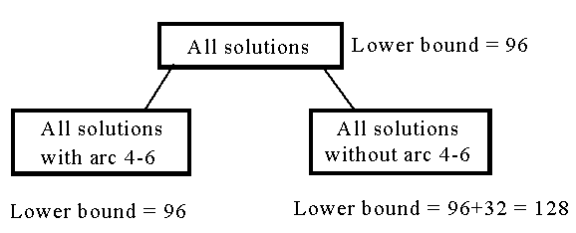
The traveling salesperson optimization problem
Total cost reduced: 84+7+1+4 = 96 (lower bound)
decision tree:
The Highest Level of a Decision Tree.
If we use arc 3-5 to split, the difference on the lower bounds is 17+1 = 18.

Slide 20
Heuristic to select an arc to split the solution space
If an arc of cost 0 (x) is selected, then the lower bound is added by 0 (x) when the arc is included.
If an arc <i,j> is not included, then the cost of the second smallest value (y) in row i and the second smallest value (z) in column j is added to the lower bound.
Select the arc with the largest (y+z)-x

Slide 21
For the right subtree
(Arc 4-6 is excluded)
We only have to set c4-6 to be ∞.
j
i
1
2
3
4
5
6
7
1
∞
0
83
9
30
6
50
2
0
∞
66
37
17
12
26
3
29
1
∞
19
0
12
5
4
32
83
66
∞
49
∞
80
5
3
21
56
7
∞
0
28
6
0
85
8
42
89
∞
0
7
18
0
0
0
58
13
∞

Slide 22
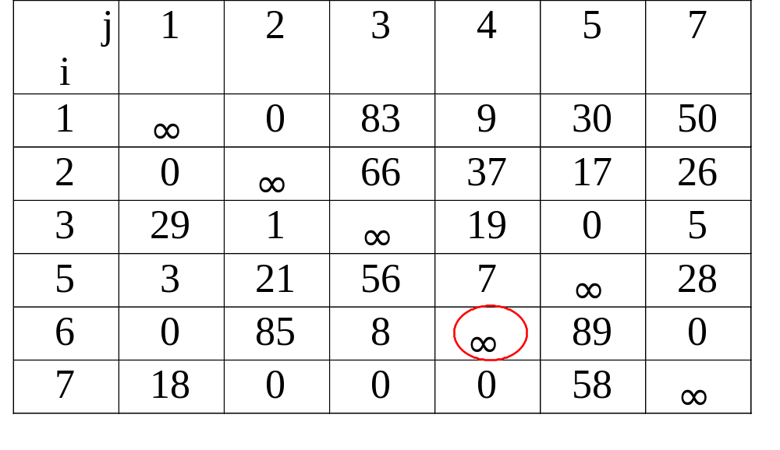
For the left subtree
(Arc 4-6 is included)
A Reduced Cost Matrix if Arc 4-6 is included.
4th row is deleted.
6th column is deleted.
We must set c6-4 to be ∞. (The reason will be clear later.)

Slide 23
For the left subtree
The cost matrix for all solution with arc 4-6:
A Reduced Cost Matrix for that in Table 6-6.
Total cost reduced: 96+3 = 99 (new lower bound)
j
i
1
2
3
4
5
7
1
∞
0
83
9
30
50
2
0
∞
66
37
17
26
3
29
1
∞
19
0
5
5
0
18
53
4
∞
25
(-3)
6
0
85
8
∞
89
0
7
18
0
0
0
58
∞

Slide 24
Upper bound
We follow the best-first search scheme and can obtain a feasible solution with cost C.
C serves as an upper bound of the optimal solution and many branches may be terminated if their lower bounds are equal to or larger than C.

Slide 25
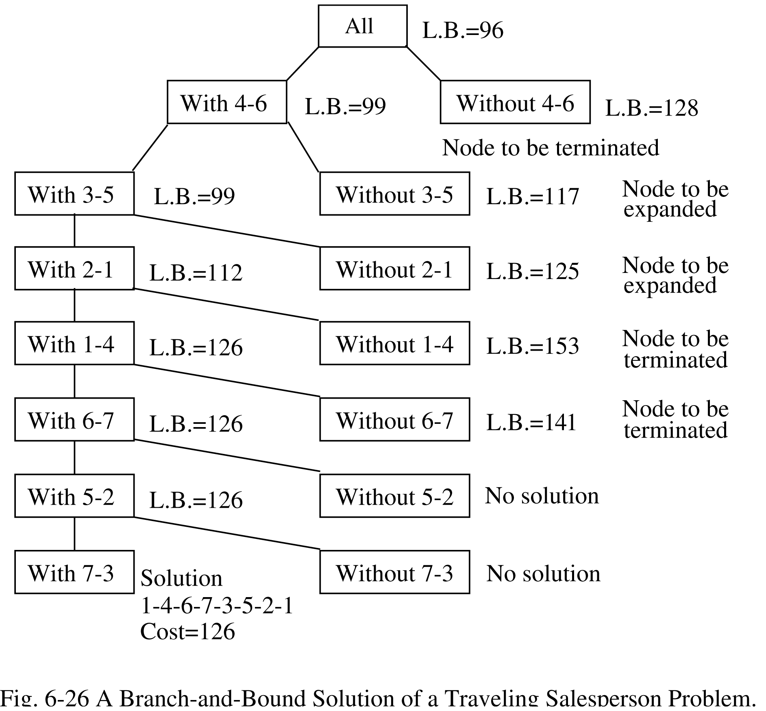
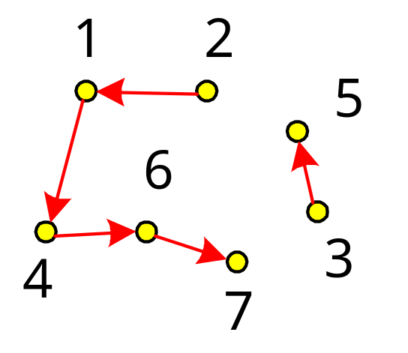
Fig 6-26 A Branch-and-Bound Solution of a Traveling Salesperson Problem.

Slide 26
Preventing an arc
In general, if paths i₁-i₂-…-i_{m} and j₁-j₂-…-j_{n} have already been included and a path from i_{m} to j₁ is to be added, then path from j_{n} to i₁ must be prevented (by assigning the cost of j_{n} to i₁ to be ∞)
For example, if 4-6, 2-1 are included and 1-4 is to be added, we must prevent 6-2 from being used by setting c6-2=∞. If 6-2 is used, there will be a loop which is forbidden.

Slide 27
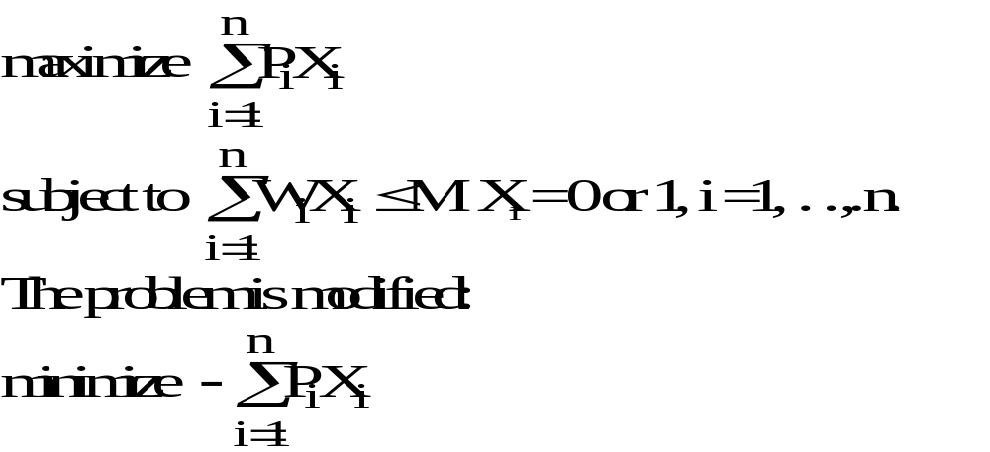
The 0/1 knapsack problem
Positive integer P₁, P₂, …, P_{n} (profit)
W₁, W₂, …, W_{n} (weight)
M (capacity)

Slide 28
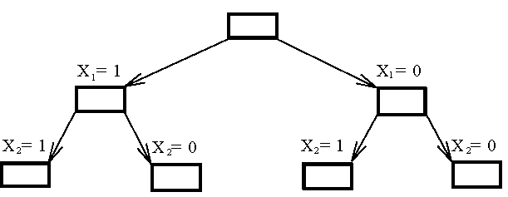
The 0/1 knapsack problem
Fig. 6-27 The Branching Mechanism in the Branch-and-Bound Strategy to Solve 0/1 Knapsack Problem.

Slide 29
How to find the upper bound?
Ans: by quickly finding a feasible solution in a greedy manner: starting from the smallest available i, scanning towards the largest i’s until M is exceeded. The upper bound can be calculated.

Slide 30
The 0/1 knapsack problem
E.g. n = 6, M = 34
A feasible solution: X₁ = 1, X₂ = 1, X₃ = 0, X₄ = 0,
X₅ = 0, X₆ = 0
-(P₁+P₂) = -16 (upper bound)
Any solution higher than -16 can not be an optimal solution.
i
1
2
3
4
5
6
P_{i}
6
10
4
5
6
4
W_{i}
10
19
8
10
12
8
(P_{i}/W_{i} ≥ P_{i+1}/W_{i+1})

Slide 31
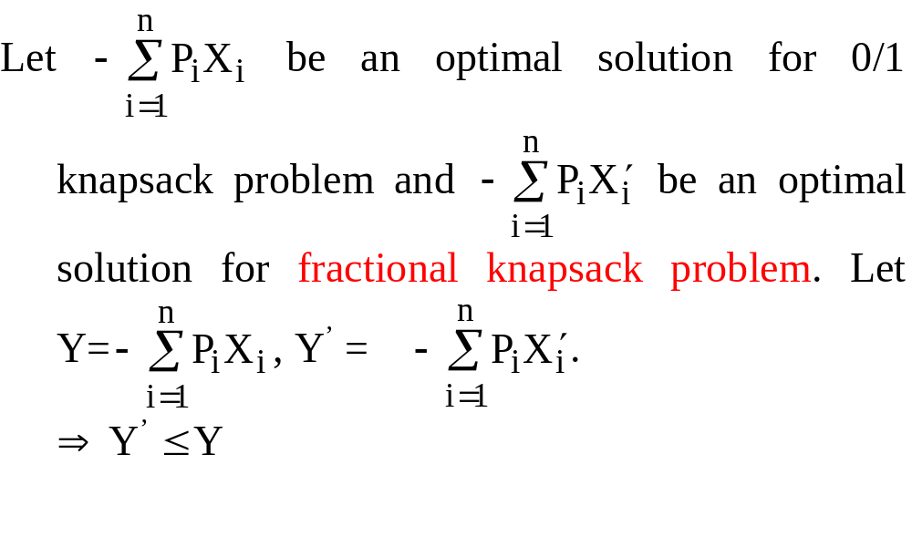
How to find the lower bound?
Ans: by relaxing our restriction from X_{i} = 0 or 1 to 0 ≤ X_{i} ≤ 1 (knapsack problem)

Slide 32
The knapsack problem
We can use the greedy method to find an optimal solution for knapsack problem.
For example, for the state of X₁=1 and X₂=1, we have
X₁ = 1, X₂ =1, X₃ = (34-6-10)/8=5/8, X₄ = 0, X₅ = 0, X₆ =0
-(P₁+P₂+5/8P₃) = -18.5 (lower bound)
-18 is our lower bound. (We only consider integers, since the benefits of a 0/1 knapsack problem will be integers.)

Slide 33
How to expand the tree?
By the best-first search scheme
That is, by expanding the node with the best lower bound. If two nodes have the same lower bounds, expand the node with the lower upper bound.

Slide 34
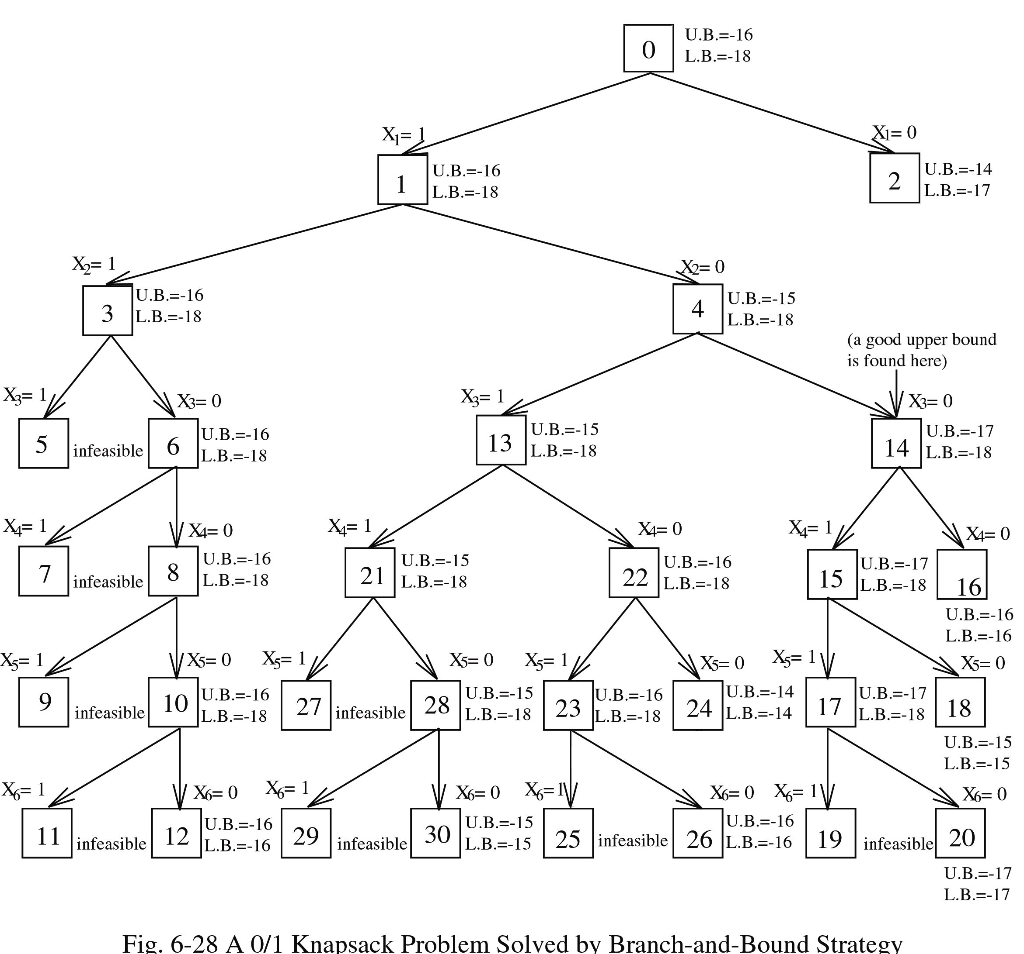
0/1 Knapsack Problem Solved by Branch-and-Bound Strategy

Slide 35
Node 2 is terminated because its lower bound is equal to the upper bound of node 14.
Nodes 16, 18 and others are terminated because the local lower bound is equal to the local upper bound.
(lower bound ≤ optimal solution ≤ upper bound)

Slide 36
The A* algorithm
Used to solve optimization problems.
Using the best-first strategy.
If a feasible solution (goal node) is selected to expand, then it is optimal and we can stop.
Estimated cost function of a node n : f(n)
f(n) = g(n) + h(n)
g(n): cost from root to node n.
h(n): estimated cost from node n to a goal node.
h*(n): “real” cost from node n to a goal node.
f*(n): “real” cost of node n
h(n) ≤ h*(n)
⇒ f(n) = g(n) + h(n) ≤ g(n)+h*(n) = f*(n) …………. (1)
Estimated further cost should never
exceed the real further cost.

Slide 37
Reasoning
Let t be the selected goal node. We have f*(t)=f(t)+h(t)=f(t)+0=f(t)…..(2)
Assume that t is not the optimal node. There must exist one node, say s, that has been generated but not selected and that will lead to the optimal node.
Since we take the best first search strategy, we have f (t)≤f(s)……(3).
We have f*(t)=f(t)≤f(s)≤f*(s) by Eqs. (1), (2) and (3), which means that s is not the node leading to the optimal node. Contradiction occurs.
Therefore, t is the optimal node.

Slide 38
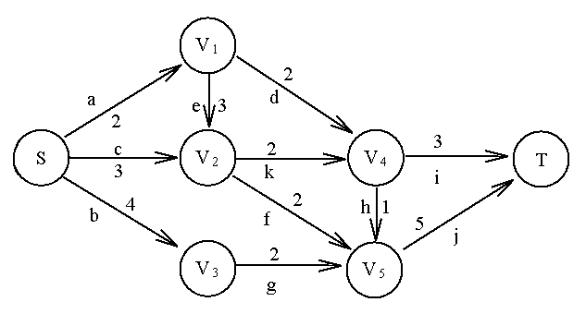
The A* algorithm
Stop when the selected node is also a goal node. It is optimal iff h(n)≤h*(n)
E.g.: To find a shortest path from node s to node t

Slide 39
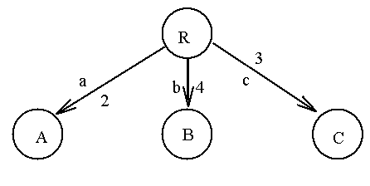
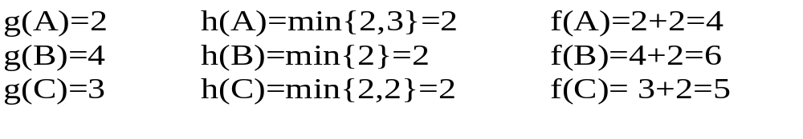
The A* algorithm
Step 1.

Slide 40
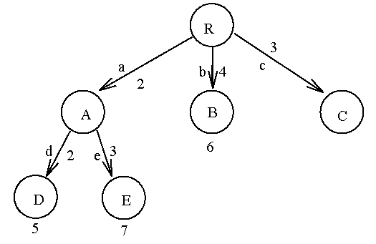
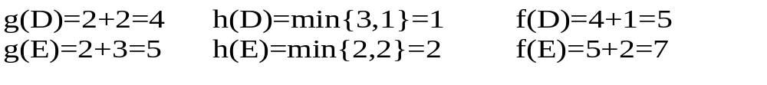
The A* algorithm
Step 2. Expand A

Slide 41
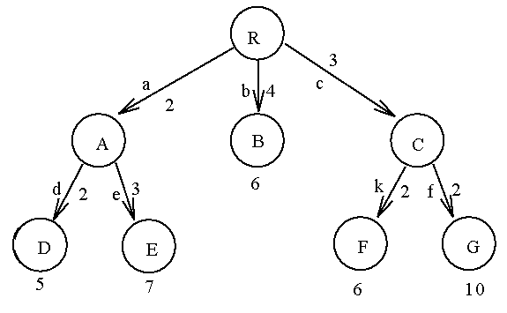
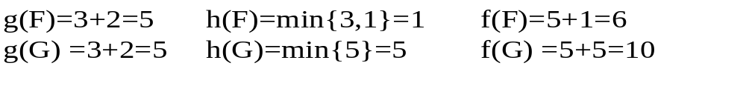
The A* algorithm
Step 3. Expand C

Slide 42
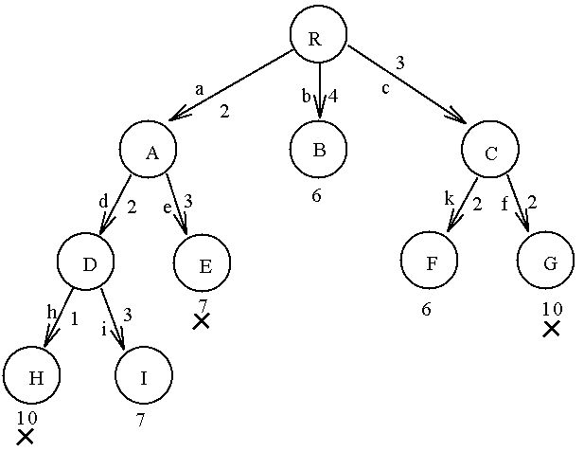
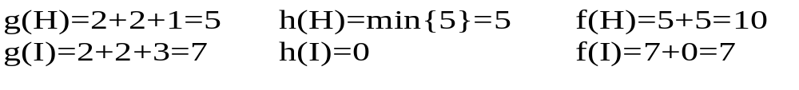
The A* algorithm
Step 4. Expand D

Slide 43
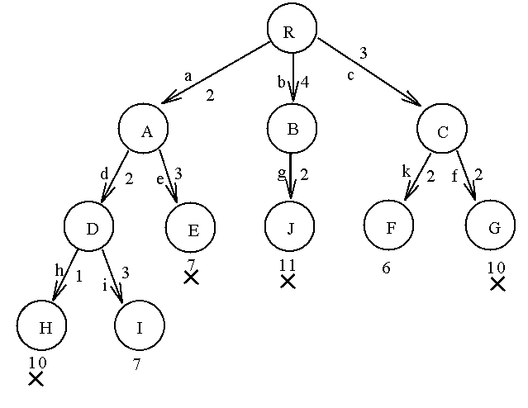
The A* algorithm
Step 5. Expand B

Slide 44
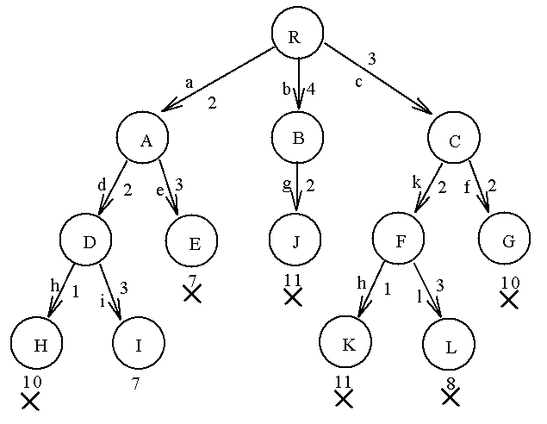
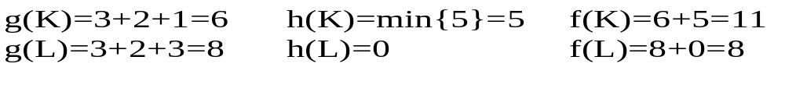
The A* algorithm
Step 6. Expand F
I is selected to expand.
The A* algorithm stops,
since I is a goal node.

Slide 45
The A* Algorithm
Can be considered as a special type of branch-and-bound algorithm.
When the first feasible solution is found, all nodes in the heap (priority queue) are terminated.
* stands for “real”
“A* algorithm” stands for
“real good algorithm”

Slide 46
Q&A

